Slide 1
MINI PROJECT PPT
ON
Blockchain Enabled Security Framework
Submitted to: Submitted by:
Dr. Neha Tripathi Ankit Pundir
Section- D Course- BTech
Group –G1 Branch- CSE
Class Roll No- 07 Uni Roll No-2018686

Slide 2
PHOTO STORAGE USING BLOCKCHAIN
This project we've established a decentralized Google Drive-like system using React JS for the front end and Solidity for the back end. Leveraging the power of IPFS through Pinata, we ensure secure and tamper-proof photo storage with unique hash generation .
Smart contracts govern access control, guaranteeing privacy and user control. The backend is reinforced by Hardhat, ensuring efficient interactions with Ethereum, while MetaMask integration enhances user authentication.
This helps in reshaping photo management, making it secure, transparent, and user-centric.

Slide 3

What Is Blockchain Technology
A decentralized peer-to-peer network
A collective trust model among unknown peers
A distributed immutable ledger of records of transactions.
What is Cryptography?
The word “Crypto” means hiding and “Graphy “means writing.
It is the art of secret writing with the intent of keeping the data safe.
It uses different encryption algorithm such as Rivest Shamir Adleman Algorithm.

Slide 4
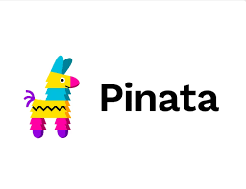
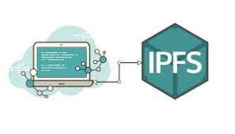
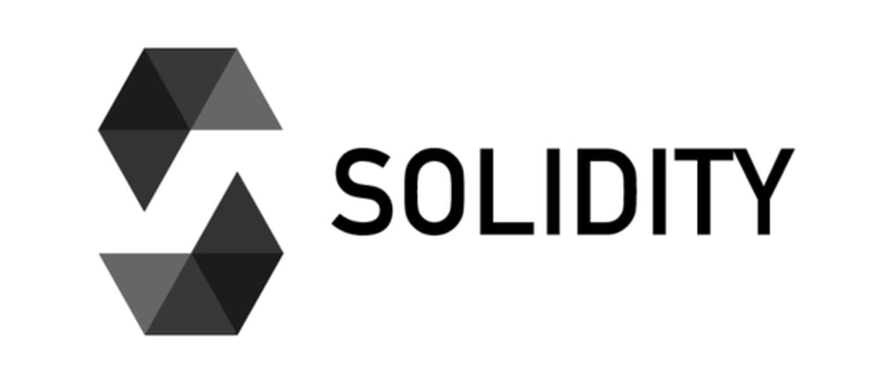
Pre-requisites
Smart Contract - A Smart Contract provides the very powerful capability of “code execution” for embedding business logic on a Blockchain.
Solidity -Solidity is the high-level programming language code for writing smart contracts that run on EVM. Ethereum Virtual Machine (EVM) is a special structure where code is deployed on after being translated into byte-code . It enables developers to create decentralized applications (DApps).
Pinata - Pinata is a user-friendly and reliable platform that facilitates the uploading and management of files, particularly on the InterPlanetary File System (IPFS). It simplifies the process of storing data on IPFS by providing a gateway and tools for content pinning, ensuring accessibility and permanence.

Slide 5

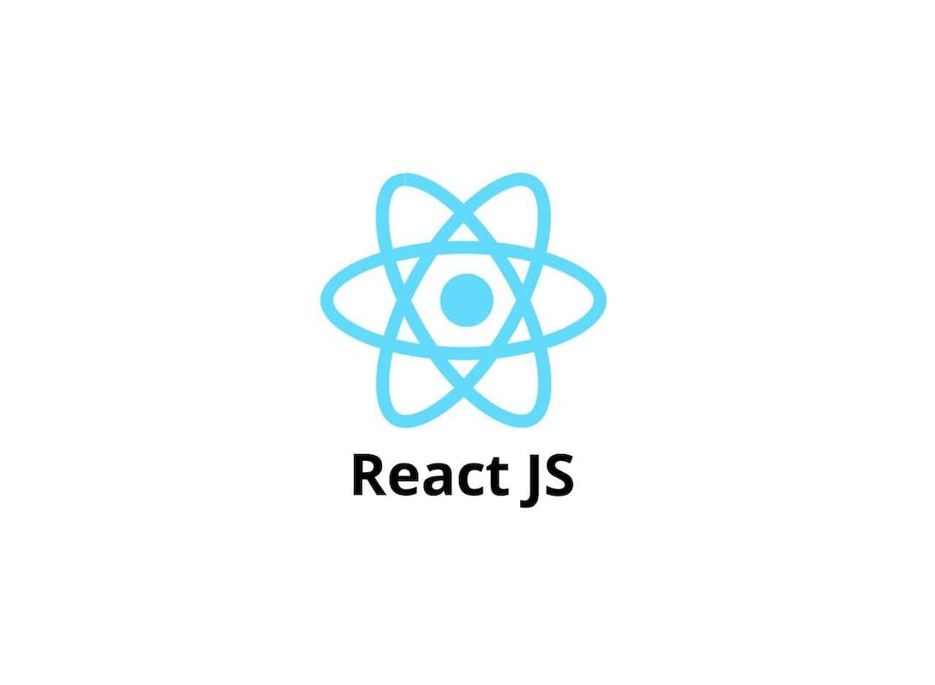
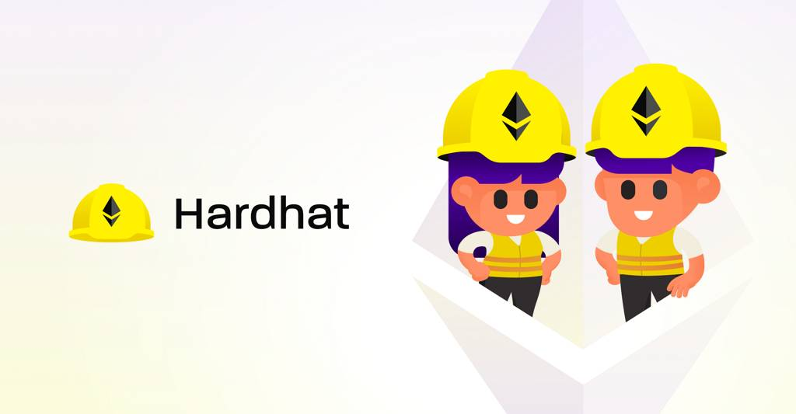
Pre-requisites
Hardhat – Hardhat is a development environment for Ethereum based projects. It facilitates the compilation, testing, and deployment of smart contracts on the Ethereum blockchain.
Metamask -MetaMask is a cryptocurrency wallet and gateway to the decentralized web. It allows users to manage their Ethereum-based assets, interact with decentralized applications (DApps), and securely store private keys. MetaMask is commonly used as a browser extension and simplifies the process of interacting with blockchain-based applications.
ReactJS - ReactJS is an open-source JavaScript library used for building user interfaces, particularly for single-page applications where user interactions need to be highly responsive.

Slide 6
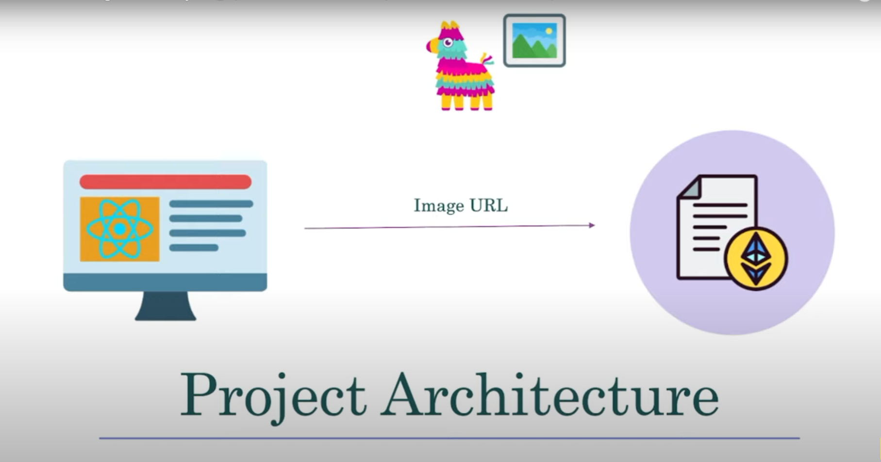
METHODOLOGY
1. Smart Contract Deployment:
Deploy the smart contract,on the Ethereum blockchain using a development environment such as Remix or Hardhat.
Ensuring proper deployment and interaction by testing the contract functions with test accounts.

Slide 7
METHODOLOGY
2. User Registration and Smart Contract Interaction:
Users register on the Google Drive platform, each receiving a unique Ethereum address.
Implementing a user interface (using React JS) to interact with the smart contract functions for photo uploading, access control, and retrieval.
3. Photo Upload to IPFS using Pinata:
Integration of Pinata API to facilitate the uploading of photos to IPFS.
When a user uploads a photo, generate a unique IPFS hash for the image using Pinata and store the hash on the Ethereum blockchain via the 'add' function in the smart contract.
4. Access Control Management:
Implement a user-friendly interface to allow users to manage access to their photos.
Use the 'allow' and 'disallow' functions in the smart contract to control ownership and access rights.
Ensure that only authorized users, as specified in the smart contract, can access and manage photos.

Slide 8
METHODOLOGY
5. Front-End Development with React JS:
Development of the front-end interface using React JS to provide an intuitive user experience for uploading, managing, and sharing photos.
Connecting the React JS application to the smart contract using Ether.js for seamless interaction with the Ethereum blockchain.
6. Integration with MetaMask:
Integration of MetaMask for secure user authentication and interaction with the Ethereum blockchain.
Ensuring that users can connect their MetaMask wallet to the Google Drive platform to manage their photos securely.
7. Testing and Debugging:
Conducting comprehensive testing of the entire system to identify and rectify any bugs or vulnerabilities.
Testing various scenarios, such as photo uploads, access control changes, and interactions with MetaMask, to ensure a robust and reliable system.

Slide 9
IMPORTANT TERMINAL COMMANDS
npm start(to start website)
npx hardhat node(To run local blockchain and get accounts with their private keys)
npx hardhat run --network localhost scripts/deploy.js(To deploy our smart contract on a local blockchain provided by hardhat)
npm install axios(Axios is used to interact with pinata)
npm install --save-dev hardhat@2.12.4 (To install hardhat)
npm install create-react-app(To install create react app)

Slide 10
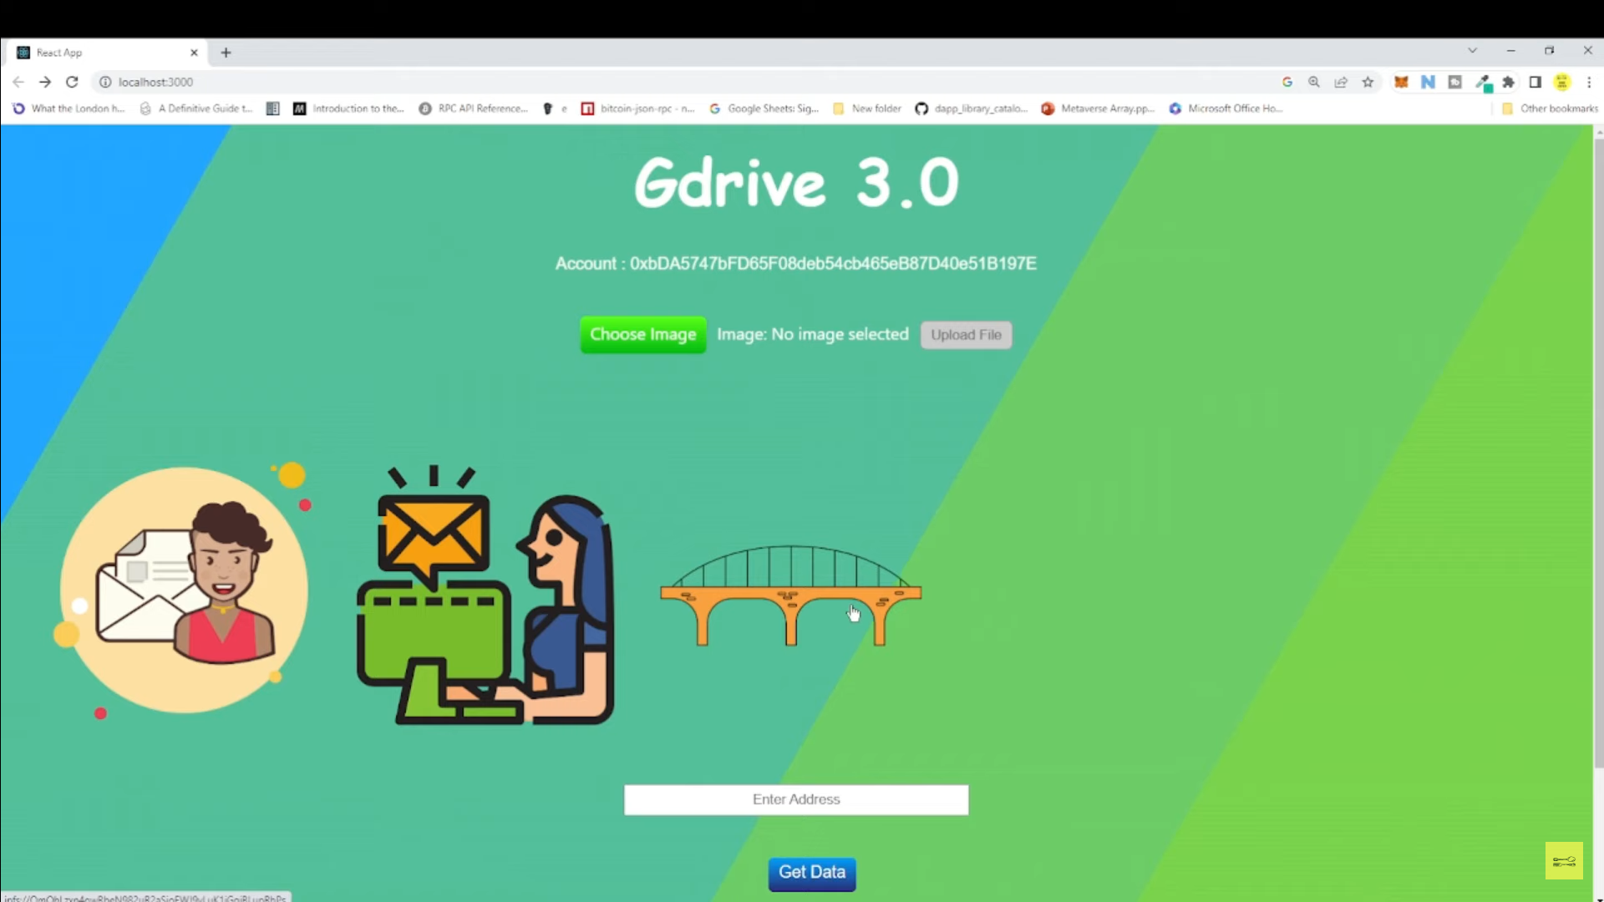
Result
The implementation of the blockchain-enabled Google Drive project, leveraging the provided smart contract, has yielded positive outcomes in terms of decentralized photo storage, access control, and user interaction.

Slide 11
CONCLUSIONS
In conclusion, the implementation of the blockchain-enabled Google Drive project has successfully demonstrated the potential of decentralized technology in revolutionizing photo storage and access control. Leveraging the Ethereum blockchain, smart contracts, and complementary technologies like IPFS, React JS, Ether.js, and MetaMask, the project offers users a secure, transparent, and user-centric platform for managing their cherished memories. The decentralized nature of photo storage enhances security, while the implemented access control mechanisms empower users to dictate who can view their photos. The user-friendly React JS front-end and MetaMask integration contribute to a seamless and intuitive experience.

Slide 12
FUTURE WORKS
1: Support for Large Size Images.
2: Display format(height and width) in cases of bigger images.
3: Support for all kinds of files such as videos,text,mp3,zip .etc.

Slide 13
THANK YOU

